Slide 1
HCCH Asia Pacific Week Manila 2022 session 9 Jurisdiction Project
Keisuke Takeshita
Professor of Private International Law
Graduate School of Law, Hitotsubashi University (JAPAN)

Slide 2
Introduction
History of the Project
Core Issues of the Project
Objectives and Benefits
Current Discussion in the WG
Concluding Remarks

Slide 3
1. History of the Project
2012 2013 2019 2020 2021 2022
1st Meeting of EG
3rd Meeting of EG
5th Meeting of EG
2nd Meeting of WG
2nd Meeting of EG
22nd Diplomatic Session
4th Meeting of EG
1st Meeting of WG
3rd Meeting of WG
CGAP
2019
CGAP
2020
CGAP
2021
CGAP
2022

Slide 4
2. Core Issues of the Project
Remaining issues that are not dealt with in 2005 Choice of Court Convention and 2019 Judgments Convention
Related Actions or Claims
Jurisdiction
Jurisdiction
Parallel Proceedings
Related Actions or Claims
＋
Flexible Mechanism for Communication among courts
Parallel Proceedings
Flexible Mechanism
for Communication

Slide 5
3. Objectives and Benefits
“Access to justice for all” in transnational civil or commercial litigation
Adjudication of disputes in an appropriate forum
Benefits of new instrument[s]
Providing greater predictability and certainty
Reducing costs for the dispute resolution
Avoiding the risks of the inconsistent judgments

Slide 6
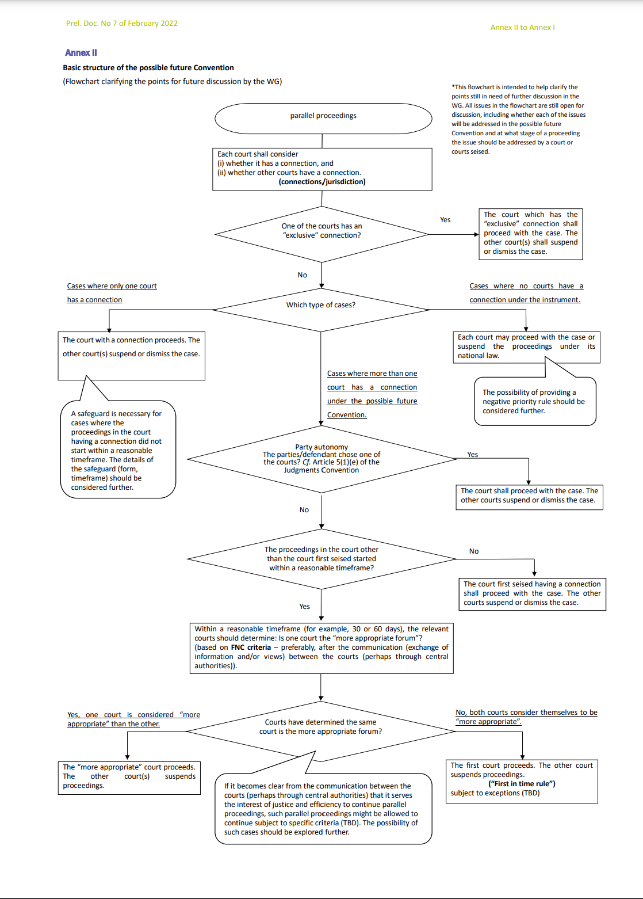
4. Current Discussion in the WG
Discussion on rules for parallel proceedings
“[T]he primary role of both jurisdictional rules and the doctrine of forum non conveniens” (Para. 9 (b) of Conclusion & Recommendation of 2021 CGAP)
The basic structure of rules described in the “flowchart”
Using certain connections to Contracting States (grounds of jurisdiction)
Determining the more appropriate forum in consideration of various factors (based on FNC criteria) in cases where s where more than one court has a connection under the possible future Convention
Giving priority to the court first seised when the courts of parallel proceedings do not reach the same decision on the appropriate forum
Annex II of Annex I to the Report of the Working Group on Jurisdiction
Prel. Doc. No 7 of February 2022 (2022 CGAP)

Slide 7
5. Concluding Remarks
The Age of Global Cooperation
Difference of the current social environment from that in early 1900s when Japan tried to participate in HCCH
Global judicial cooperation based on mutual trust
New Instrument[s] for the Future World
Instrument[s] not only for our generation but also for the future generations
Constructive flexibility in the discussion
Necessity of new ideas based on creative imagination

Slide 8
Thank you for your attention
Keisuke Takeshita
Professor of Private International Law
Graduate School of Law, Hitotsubashi University (JAPAN)
kei.ｔakeshita＠r.hit-u.ac.jp

